Slide 1
Scientific Research in Information Systems
CHAPTER 3
THE RESEARCH PROCESS
JAN RECKER

Slide 2
Overview
The Research Process
Research Questions
Motivation
Specification of Problem Statement
Justification
Research Design
Observation, Induction and Deduction
Selecting a Research Design
Research Methodology
The Role of Literature in the Research Process
Further Reading

Slide 3
Research Questions
A research question should be a key statement that identifies the phenomenon to be studied. The research question(s) is/are the fundamental cornerstone around which your whole doctoral research revolves and evolves.
Some of the problems about the formulation of research questions are:
The elevator speech problem
The “so what” problem
The “solving-the-world” problem
The “insolvability” problem
The “multitude” problem
Notes:
1. The elevator speech problem: The problem here is that you don’t fully understand your research question yourself, or you cannot articulate it properly. A good research question is simply a short question.
2. The “so what” problem: You have a research question, but it simply doesn’t matter to anyone. There should be practical merit (utility) in the research.
3. The “solving-the-world” problem: Your research question is indeed important. But it simply cannot be answered given the resource constraints. (time constraints, regulations prescribed by your institution etc.)
4. The “insolvability” problem: Your question simply cannot be answered meaningfully. Sometimes this is because of a logical problem in the question, because the information needed to answer the question cannot be logically or legally obtained, or because the answer is so hard to obtain that feasibility of the research within the constraints is not possible.
5. The “multitude” problem: a good study sets out to answer one question. Maybe two if you are ambitious. Nothing is gained by setting out to answer six questions.

Slide 4
Research Questions (cont.)
To find a good research question, we can utilize a number of guiding questions.
Do you know in which field of research the research question(s) is/are?
Do you have a firm understanding of the body of knowledge in that field (how well do you know the relevant domain literature)?
What are the important established research questions in the field?
What areas need further exploration?
Could your study fill an important gap? Will it lead to greater understanding?
How much research has already been conducted in this topic area?
Has your proposed study been done before? If so, is there room for improvement?
Is it a sustainable and important topic or is it currently hot but at the risk of becoming obsolete (a fad)?
Who would care about obtaining an answer to the question?
Will your proposed study have a significant impact on the field?

Slide 5
Research Questions (cont.)
While formulating a good research question three key components should be considered.
Motivation
Specification of Problem Statement
Justification

Slide 6
Motivation
Asking a research question is the logical, necessary, and inevitable conclusion to a set of arguments.
These arguments stress that there is (1) an important problem domain with (2) an important gap of knowledge about (3) a particularly important phenomenon that deserves attention from the research community.
A motivation is not necessarily extensive, as long as it addresses these three points.

Slide 7
Specification of Problem Statement
Research questions are typically categorized in one of two types, based on the issues that they delve into:
“What”, “who,” and “where” questions tend to focus on issues where we seek to explore and describe a topic where little knowledge exists to date.
“How” and “why” questions are explanatory and seek to provide an answer about the causal mechanisms that are at work regarding a particular phenomenon.
Developing the question as your problem statement is probably one of the most important steps in a doctoral study.
Guidelines for structuring research questions hierarchically can be beneficial to doctoral students. A common approach to hierarchical structuring attempts to distinguish managerial from research and investigative questions
Notes:
A managerial question states the driving question of the study.
A research question captures the general purpose of the study. It is derived from the managerial question, and translates it into a research problem.
An investigative question then identifies question(s) that must be answered in order to address the research question(s) more precisely.

Slide 8
Justification
A good research question comes together with a convincing argumentation for why the particular problem is significant and deserves our attention.
A good research question is:
Feasible
Interesting to the investigator
Novel
Ethical
Relevant
Notes:
In the motivation, you argue why the domain should be examined and which phenomena within warrant attention.
In the specification of the research question, you define one particular aspect of some phenomena that you propose to examine from a particular angle.
In the justification step, you should now offer some arguments as to why this particular focus, demonstrated in the research question(s), is warranted.
Feasible: Adequate subjects of study are available, technical expertise is available, time and money are available, and the scope is manageable.
Interesting to the investigator: You are confident that you can maintain an interest in the topic and maintain your own motivation to study it for several years.
Novel: An answer to the question will confirm or refute previous findings or provide new findings.
Ethical: Pursuing and answering the question will not violate ethical principles for the conduct of research, and will not put the safety of the investigators or subjects at risk.
Relevant: both the question and the future answer(s) are important in the sense that they inform scientific knowledge, industry practice, and future research directions.

Slide 9
Research Design
Research design
is plan of action to answer the question.
is the blueprint for the collection, measurement, and analysis of data.
Some themes are common in all types of research designs:
Observation
Induction
Deduction

Slide 10
Observation, Induction and Deduction
Observation
concerns the discovery of things encountered in common experience
promotes the desire to understand these observable things by discovering some systematic order in them.
forms of observation involve exploratory or descriptive research.
Induction
is reasoning that involves moving from a set of specific facts to a general conclusion or from specific observations to broader generalizations and theories
case study research is a good example of induction.
Deduction
is reasoning that involves deriving arguments as logical consequences of a set of more general premises.
is commonly used to predict the results of the hypotheses or propositions.
Notes:
Deduction can be viewed as an attempt to test concepts and patterns known from theory using new empirical data.

Slide 11
Observation, Induction and Deduction
Sound research design, therefore, should strive to employ combinations of observation, induction, and deduction.
That way we can achieve a meaningful mix of;
exploration – where we build an understanding of the phenomena that interests us,
rationalisation – where we begin to make sense of the puzzle or problem that interests us, and
validation – where we appropriately subject our emergent or developed theory to rigorous examination.

Slide 12
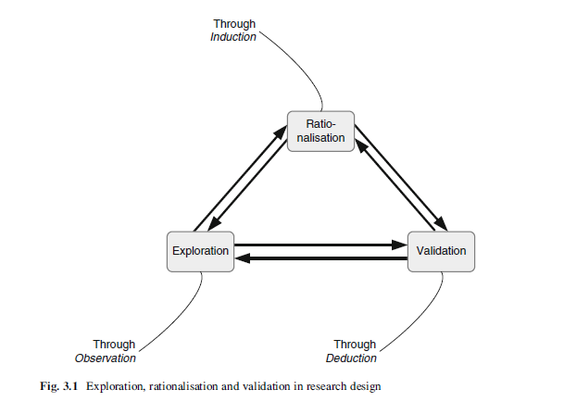
Observation, Induction and Deduction
Notes:
A good research typically moves back and forth between them, as shown in Fig. 3.1.

Slide 13
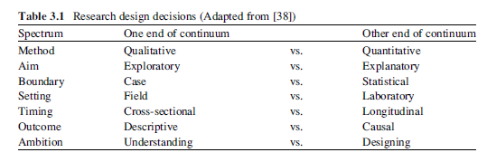
Selecting a Research Design
Research design is the outcome of a process with many choices.
Notes:
Table 3.1 summarises some of the important design decision parameters. Note that by no means are these decision binary (either-or) in nature; rather, they exist as two key points along a continuum of choices.
The research question determines, at least to a large extent, the choices required in selecting a research design.

Slide 14
Selecting a Research Design
Research design needs to account for several other considerations. The most important ones can be summarized as follows:
Data: What type of data is required? Where can I collect observations or other forms of evidence? How will I sample the relevant data?
Risks: What are the potential dangers associated with execution of the research design? What are strategies available to minimize or mitigate these risks?
Theory: Which and how much literature concerning the phenomena of interest is available? Where are gaps in the knowledge base?
Feasibility: can the research design be executed within the constraints associated with a doctoral study such as time limitations, resource limitations, funding, experience, geographic boundaries, and others?
Instrumentation: how will my constructs of interest be measured? Will my construct operationalization be appropriate given the choice of research methodology and set of data available?
Notes:
Note: Set out to answer an important question; it is not appropriate to find an answer and then devise a question that fits the answer!

Slide 15
Research Methodology
One of the key design choices in research design relates to the use of the research methodology.
Research Methodology is a term that describes the strategy of inquiry used to answer a specific research question.
Creswell (2009) states that strategies of inquiry are “types of qualitative, quantitative and mixed methods designs that provide specific direction for procedures in a research design”.
In this book, design science methods are added as an additional orthogonal strategy of inquiry to his list.

Slide 16
Research Methodology (cont.)
Quantitative Strategies are procedures that feature research methods such as experiments or surveys and which are characterized by an emphasis on quantitative data (think of these procedures as having a focus on “numbers”).
Qualitative Strategies are procedures that feature research methods such as case study, ethnography or phenomenology and which are characterized by an emphasis on qualitative data (think of these procedures as having a focus on “words”).

Slide 17
Research Methodology (cont.)
Mixed Methods are procedures that feature combinations of both qualitative and quantitative strategies in either sequential or concurrent fashion (think of these procedures as having a focus on “numbers and words”).
Design Science Methods are procedures that feature methods to build and evaluate novel and innovative artefacts (such as new models, methods or systems) as the outcome of a research process and which are characterized by an emphasis on the construction of the artefact and the demonstration of its utility to an organizational problem (think of these procedures as having a focus on “artefacts”).

Slide 18
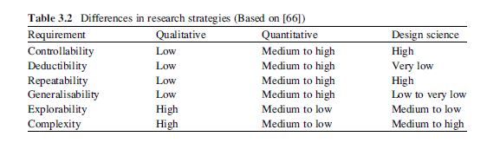
Research Methodology (cont.)
We can differentiate the three strategies alongside a number of dimensions, as summarized in Table 3.2
Notes:
All of these criteria are usually combined in a favourable way (medium to high, for example) in mixed method designs.
A valuable mixed method design, therefore, is one that combines “strong”qualitative characteristics (such as explorability or complexity) with “strong” quantitative characteristics (such as generalisability or deductability), so that the requirements that may not be fully met by one method can be compensated by the other.

Slide 19
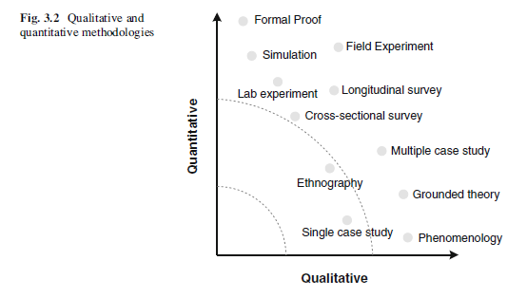
Research Methodology (cont.)
Within the realm of qualitative, quantitative, mixed or design science strategies, there are many approaches or research methods available. A research method can be viewed as one possible instantiation of a research methodology.
Notes:
Finally, there is a lot of support for the view that a combination of research methods can often be most effective in achieving a particular research objective.

Slide 20
The Role of Literature in the Research Process
We build a cumulative tradition of knowledge by adding with our own published research to this repository of knowledge.
We publish our research in the form of book chapters, books, and journal articles.
This tradition demands that you spend a significant amount of time and effort to acquire and critically appraise this cumulative knowledge base.
You will not be able to add significantly to the body of knowledge without having a firm understanding of where that body of knowledge currently stands.
Where a firm understanding of the body of knowledge is required for many of the decisions regarding the planning stages of research.

Slide 21
The Role of Literature in the Research Process (cont.)
The literature may be important in terms of:
Findings and insights into a specific problem domain;
Theories that are available and/or in use to examine the problem or phenomena of interest; and
The current state of the methodologies appropriate and applicable to the study.
In consuming the literature, it helps to follow a process of read-think-interpret.

Slide 22
The Role of Literature in the Research Process (cont.)
Three good reasons for expanding your literature search outside of your immediate domain are:
Discovering theories that are popular in other research fields, aside from those that are domain-specific.
Seeing the way methods are applied in other research disciplines, especially in terms of the guidelines and evaluation criteria available.
Developing an exposure to the way other scholars in other fields frame, examine, and solve real world problems, in a very general sense. This can be an incredible source of inspiration and can make for a tipping point in your own journey.

Slide 23
Further Reading
Creswell, J.W.: Research Design: Qualitative, Quantitative, and Mixed Methods Approaches, 3rd edn. Sage, Thousand Oaks (2009)
Lee, A.S.: Integrating positivist and interpretive approaches to organizational research. Organ. Sci. 2, 342–365 (1991)
Leedy, P.D., Ormrod, J.E.: Practical Research: Planning and Design, 7th edn. Prentice Hall, Upper Saddle River (2001)
Weber, R.: Editor’s comments: The problem of the problem. MIS Q. 27, iii–ix (2003)

Slide 24
Thank You ☺

